Slide 1

How to Web Api
Middle Town

Slide 2
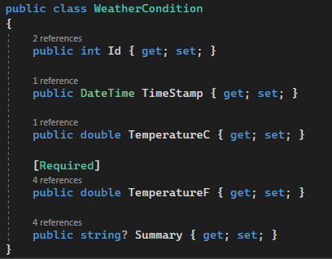
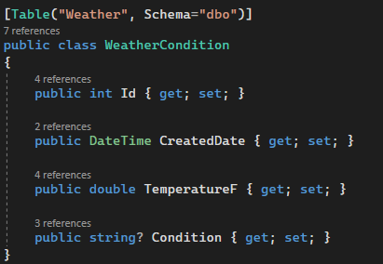
Model Types
Domain
Definition
Used throughout the “domain” of the Api
Uncoupled model that can exist independent of a database table
Used only by repositories
One to one model that mirrors its database table

Slide 3




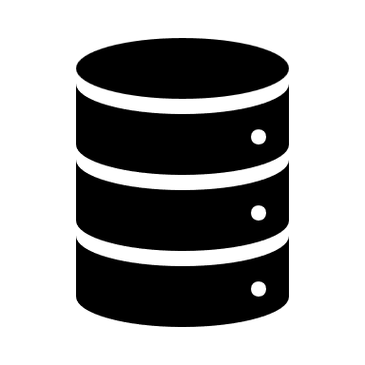
Architecture
Api
Client
Controller
Provides an interface for the client call into to get or publish data
Service
Connects the controller to the repository and does any data processing necessary
Repository
Connects directly to the database to store and fetch data
Database

Slide 4
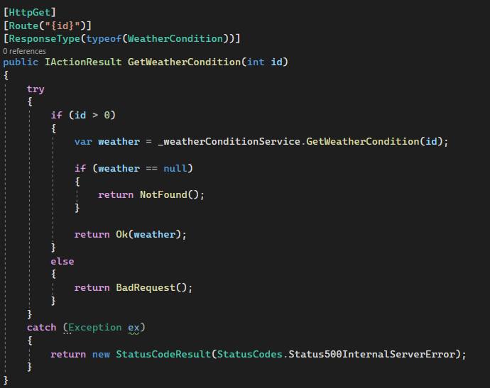
Controller
Create HTTP methods
GET – Fetches data and returns it to the client
POST – Client sends data to be saved by the api
PUT – Client sends data to update existing data
DELETE – Client sends a request to delete data
Calls service to get, save, or delete some data
Returns the appropriate response and status code

Slide 5
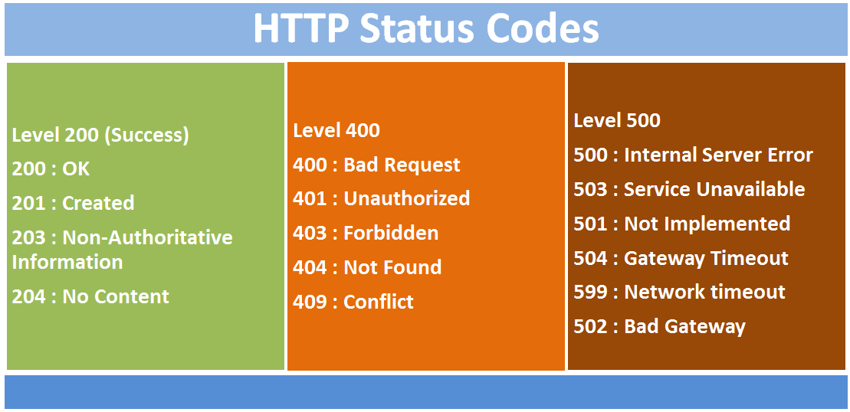
Status Codes

Slide 6
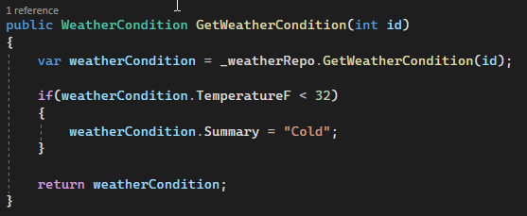
Service
Connects the controller to the Repository
The home of any logic that needs to be performed on a given Api call
If there is not logic, the service layer acts as a pass through

Slide 7
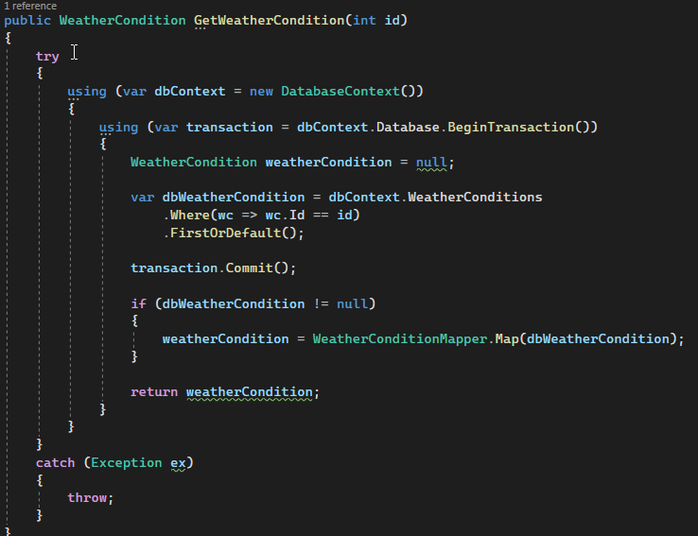
Repository
Creates database connection
The connection point for getting and saving data to the database
Typically called by the service
Calls a mapper to map the definition model to the domain model
Returns the domain model

Slide 8
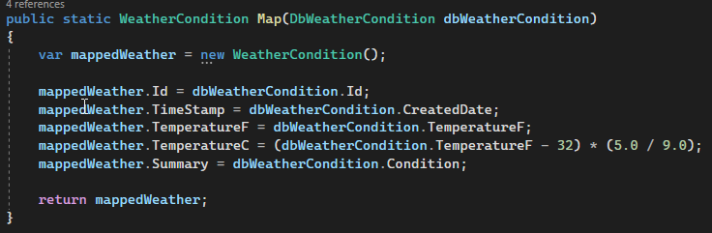
Mappers
Converts one model type to another
Commonly used in the repository when mapping the definition model to the domain model
Wrappers
Used to “wrap” calls to other Api’s
Think of it like a repository but instead of connecting to the database it connect to another Api

